Slide 1
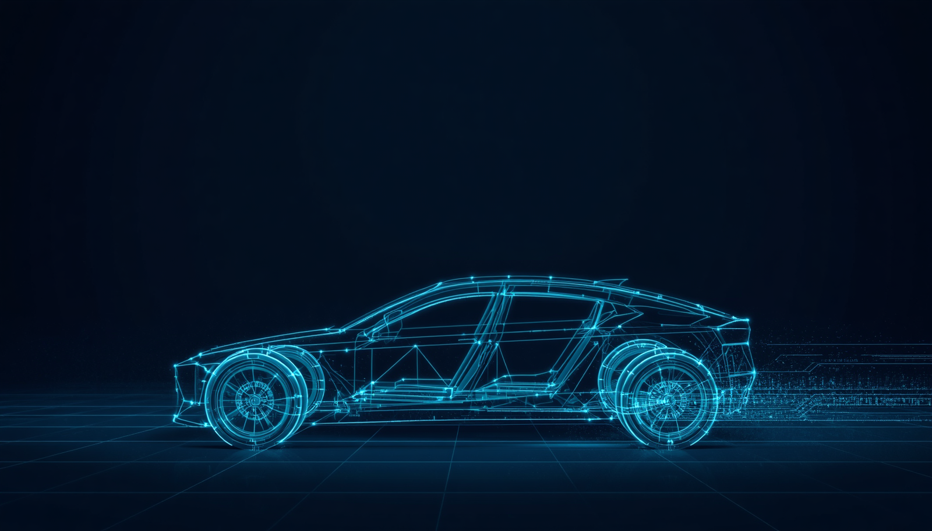

QNX ADAS: SENSOR DATA AGGREGATION SYSTEM
TEAM NAME | ONE PERCENT
TEAM MEMBERS: PAVAN R|B MANIKANTA|RANADHEER VARMA
The National Institue of Engineering

Slide 2

THE "DATA TSUNAMI" & LATENCY RISK
THE PROBLEM
THE SOLUTION
100 sensors saturate a generic bus architecture, causing dangerous latency and jitter. Data packets collide and stack, creating a chaotic red fog of uncertainty. The Jitter Meter spikes into the critical red zone—unacceptable for safety-critical autonomous systems.
Deterministic, partitioned scaling via zonal architecture. Data packets are sorted into four synchronized cyan streams flowing smoothly through dedicated zones. The Jitter Meter drops into the green zone with <5ns jitter—predictable, reliable, safe.

Slide 3



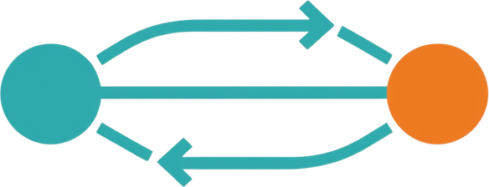
QNX MICROKERNEL: THE SHIELD AGAINST CHAOS
The QNX microkernel architecture provides deterministic message passing that ensures absolute synchronization between sensor threads and fusion processes. Unlike monolithic kernels, QNX isolates drivers in user space, preventing cascading failures and guaranteeing predictable timing.
MICROKERNEL VS MONOLITHIC
DRIVER ISOLATION
MSGSEND HANDSHAKE
QNX runs minimal code in kernel space. Drivers operate in isolated user processes, ensuring a single driver fault cannot crash the system—critical for safety-certified autonomous systems.
Each sensor driver runs in its own protected memory space. Hardware failures are contained, allowing graceful degradation without compromising the fusion engine's deterministic operation.
Sensor Thread sends via MsgSend → Fusion Thread wakes, processes, replies → Sensor Thread resumes. This synchronous IPC guarantees absolute timing synchronization (<5ns jitter).

Slide 4

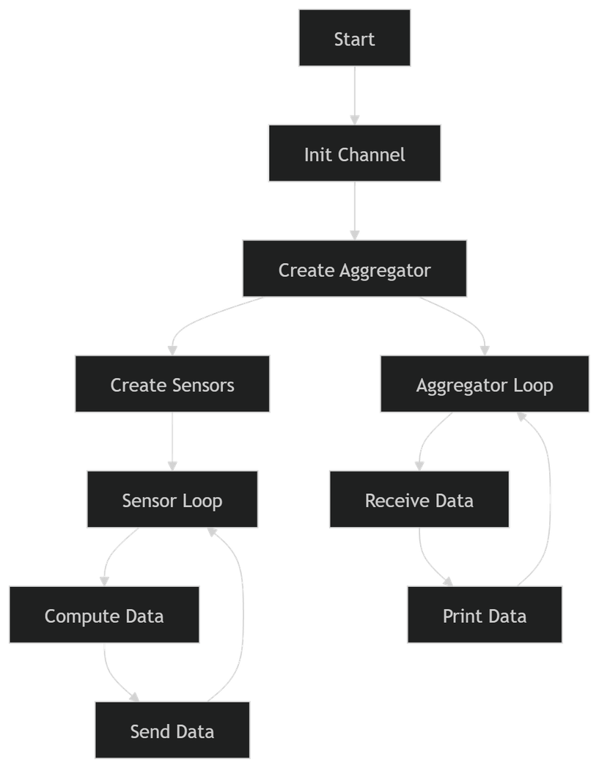
VERSION 1
PSEUDO CODE
FLOW CHART
BEGIN
INITIALIZE message_channel
CREATE aggregator_thread
FOR each sensor i:
CREATE sensor_thread(i)
END FOR
----------------------------------
FUNCTION sensor_thread(id):
WHILE TRUE:
data = perform_computation()
SEND data TO channel
END WHILE
----------------------------------
FUNCTION aggregator_thread():
WHILE TRUE:
data = RECEIVE from channel
PRINT data
END WHILE
END

Slide 5
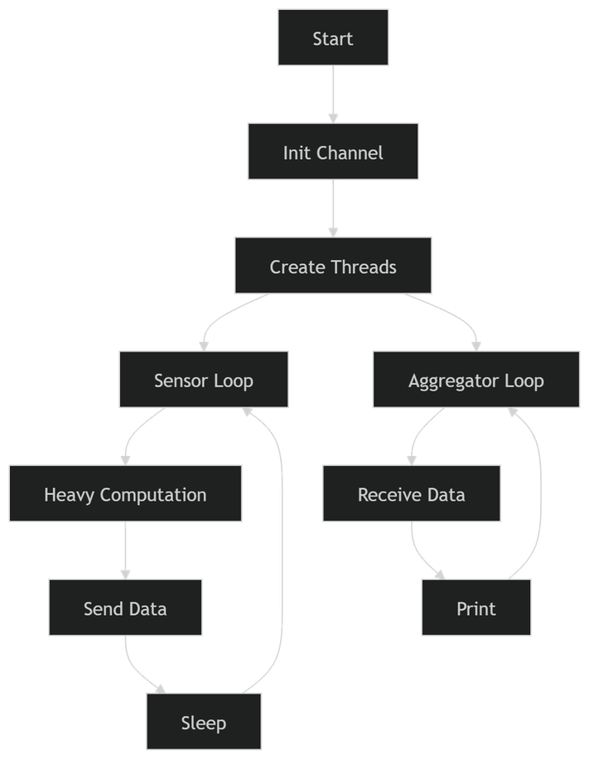
VERSION 2
PSEUDO CODE
FLOW CHART
BEGIN FUNCTION aggregator_thread():
INITIALIZE message_channel WHILE TRUE:
CREATE aggregator_thread data = RECEIVE from channel
FOR each sensor: PRINT data
CREATE sensor_thread END WHILE
END FOR END
----------------------------------
FUNCTION sensor_thread(id):
WHILE TRUE:
// Heavy CPU workload
result = heavy_computation()
SEND result TO channel
SLEEP 10 ms
END WHILE
----------------------------------

Slide 6
VERSION 3
PSEUDO CODE
BEGIN SYSTEM
INITIALIZE message_channel
CREATE aggregator_thread
FOR each sensor:
CREATE sensor_thread
END FOR
----------------------------------
FUNCTION sensor_thread(id):
WHILE TRUE:
result = heavy_computation()
send_time = current_time()
msg = {id, result, send_time}
SEND msg TO channel
SLEEP 10 ms
END WHILE
FUNCTION aggregator_thread():
WHILE TRUE:
msg = RECEIVE from channel
recv_time = current_time()
latency = recv_time - msg.send_time
PRINT id, latency
END WHILE
---------------------------------
SCHEDULER EFFECT:
IF QNX:
latency → low, stable
execution → deterministic
IF Linux:
latency → high, variable
execution → non-deterministic
END SYSTEM

Slide 7
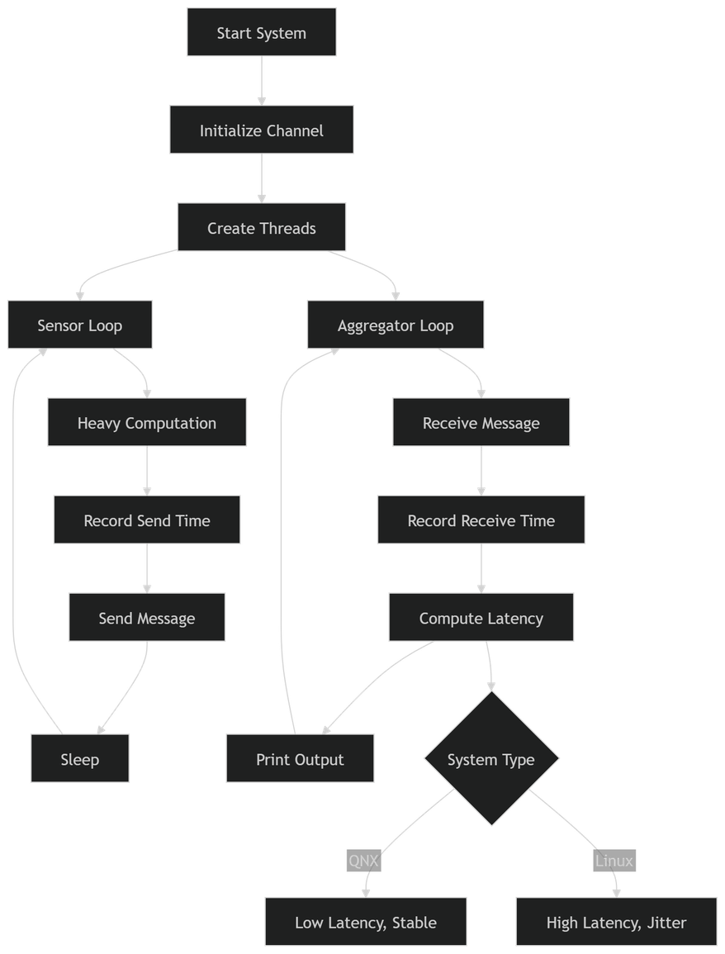
VERSION 3
FLOW CHART

Slide 8

ZONAL ARCHITECTURE: DIVIDE & CONQUER
VISION ZONE
RADAR ZONE
PROXIMITY ZONE
Core 2 allocation. Processes camera feeds, LiDAR point clouds, and optical sensors for environmental perception.
Core 1 allocation. Manages 20 radar sensors for velocity detection and obstacle ranging in all conditions.
Core 3 allocation. Ultrasonic and short-range sensors for near-field object detection and parking assist.
VITALS ZONE
FUSION ENGINE
INTERACTIVE PANEL
Core 0 allocation. Monitors vehicle health: temperature, pressure, battery status, and system diagnostics.
Cores 4-7 dedicated. Central aggregation node receiving deterministic streams from all four zones.
Click any zone to reveal core assignments, sensor lists, and real-time data flow visualization.

Slide 9

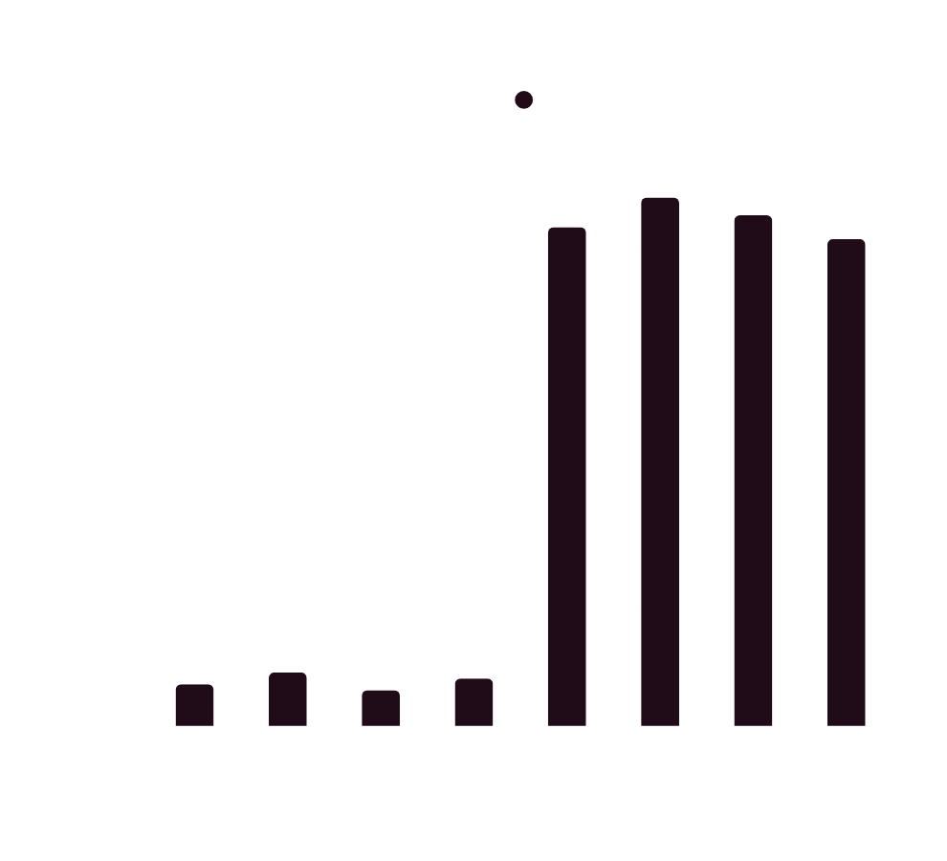
8-CORE PERFORMANCE PARTITIONING
Hardware orchestration with explicit core allocation ensuring deterministic performance and zero cache thrashing.
0-3
4-7
Ingress Cores
Fusion Cores
99.8%
0%
L3 Cache Efficiency
Cache Thrashing

Slide 10
ALGORITHMIC FUSION & TRUST
DRY SCENARIO
RAIN SCENARIO
Vision Confidence: 0.90
Radar Confidence: 0.80
Both sensors detect obstacle with high reliability. Fused confidence yields strong detection certainty. Trust weights balanced between Vision and Radar inputs.
Vision Confidence: 0.40
Radar Confidence: 0.95
Rain degrades camera visibility. Dynamic trust algorithm shifts weight to Radar. Fused output maintains high confidence through adaptive sensor prioritization.

Slide 11
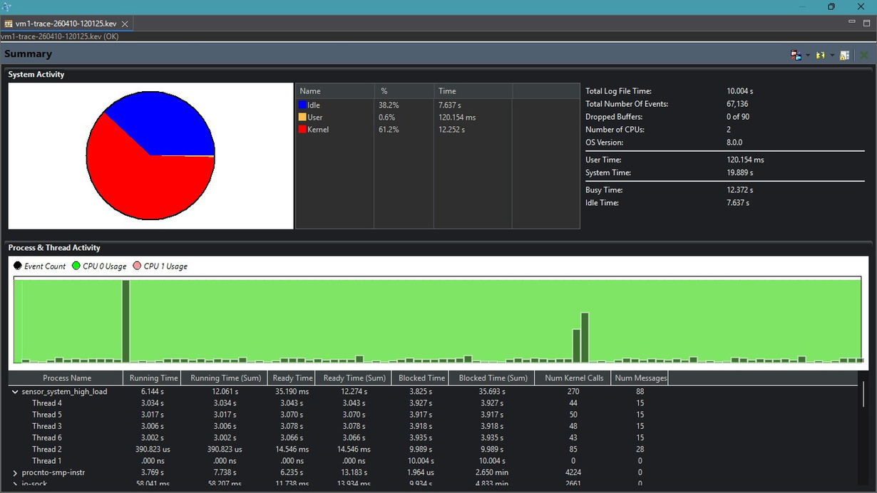
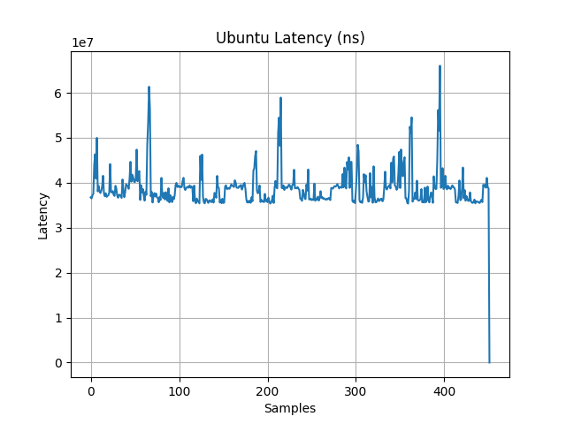
RT-LINUX V/S QNX RTOS
QNX RTOS
RT-LINUX

Slide 12
OUTPUTS OF ALL THE VERSIONS HAVE BEEN UPLOADED IN THE GITHUB REPO :
HTTPS://GITHUB.COM/PAVANRACHARYA/Q-EHACK-2026/TREE/MAIN/OUTPUTS

Slide 13

QNX ADAS: SENSOR DATA AGGREGTION SYSTEM
THANK YOU

